Slide 1
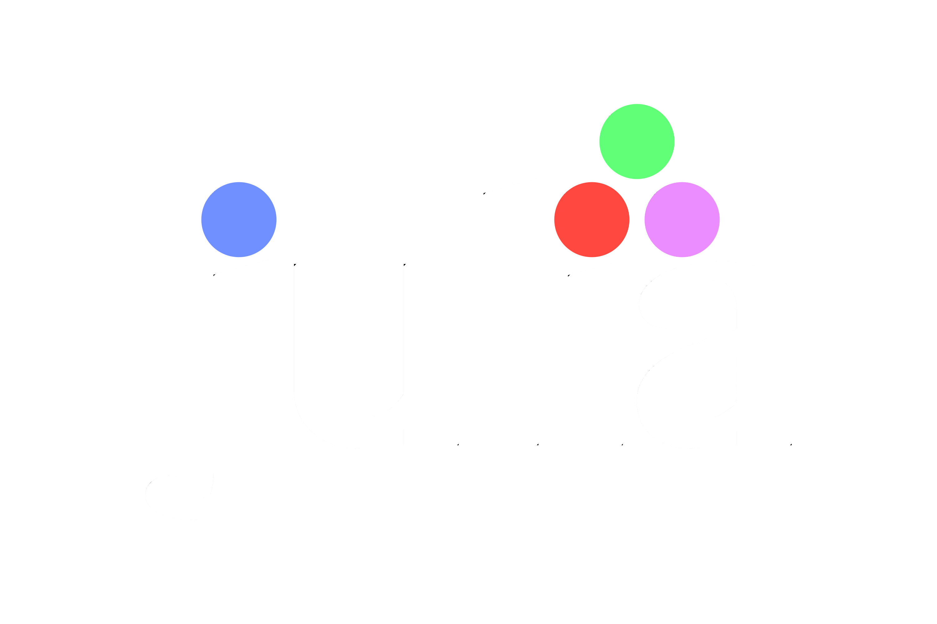
For Beginners!
© Copyright Matthew Flood, 2022
Notes:
Check that everyone has installed Plots.jl

Slide 2
For Beginners!
Week 2:
Julia Files and Modules
Type System
Collections & Data Structures
Objects
Plotting 101

Slide 3

Julia Files
When we write algorithms (our code recipes), we want to:
Fix errors as we go (AKA debugging),
Save our code to use again later,
Run our algorithms in one instant.
The files in which we do this are text files with the extension ‘.jl’
We can run all the code in a Julia file by importing it.
When we import a file, we import all the stuff in that file into the current workspace.

Slide 4
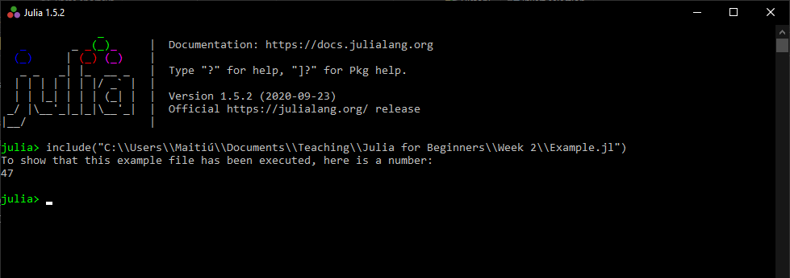
Julia Files
To load/import a Julia file, use the include() function.
e.g. include(raw“C:\\Users\\MyPC\\MyHomework.jl”))
The ‘raw’ prefix enables non-ASCII characters in the search path, like é or ü

Slide 5
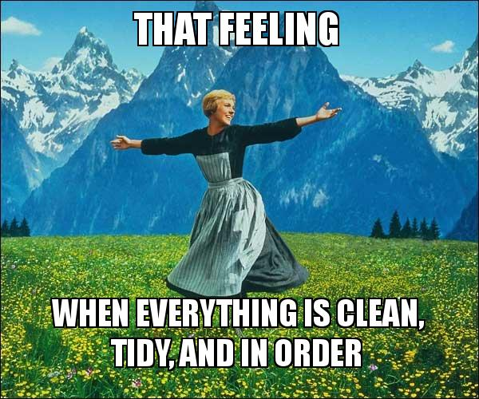
What are Modules?
Modules are a neat way of organising your code across multiple files. We will discuss functions and methods later, but we’ll use them here to demonstrate.
For example, let’s say we are working on a project to build a robot that’s only purpose is to bring you the butter when you sit at the table.

Slide 6
Creating Modules
This project will require us to write code for managing the robot’s movement, voice recognition, image (butter) recognition, and other functions.
Putting code for movement control functions in the same
file as voice recognition is messy. Instead, we can create a module and connect our project algorithms by a project name.
“Movement.jl”
“VoiceRec.jl”
“ImageRec.jl”
To do this, in the files for each job, we specify a module called “Butter_Robot”
module Butter_Robot
using LinearAlgebra
function wheel ()
…
end
.
.
.
end
module Butter_Robot
using Recorder
function listen ()
…
end
.
.
.
end
module Butter_Robot
using ComputerVision
function camera ()
…
end
.
.
.
end

Slide 7
Creating Modules
“Movement.jl”
“VoiceRec.jl”
“ImageRec.jl”
Now, when we include these files in our workspace, we can access the functions in each file with the prefix “Butter_Robot”
module Butter_Robot
using LinearAlgebra
function wheel ()
…
end
end
module Butter_Robot
using Recorder
function listen ()
…
end
end
module Butter_Robot
using ComputerVision
function camera ()
…
end
end
REPL
There is more to modules than this, but will revisit
this subject later. Here we just demonstrate how we
can group our code into modules that are related.
More info:
docs.julialang.org/en/v1/manual/modules/
en.wikibooks.org/wiki/Introducing_Julia/Modules_and_packages
julia> include(“Movement.jl”)
julia> include(“VoiceRec.jl”)
julia> include(“ImageRec.jl”)
Butter_Robot.wheel()
Butter_Robot.listen()
Butter_Robot.camera()

Slide 8
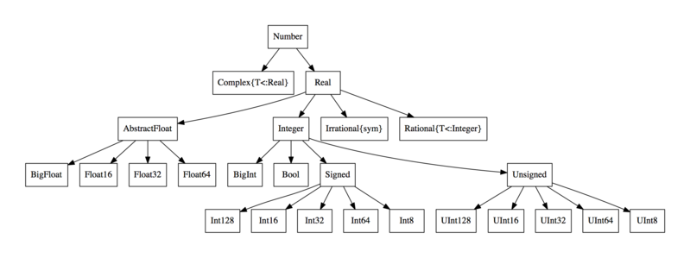
Numeric Type System
Data types are like pronouns in spoken language.
They obey subtle rules and in order to use the language properly, you have to know the rules.
Numeric data types follow a hierarchy as shown here.

Slide 9
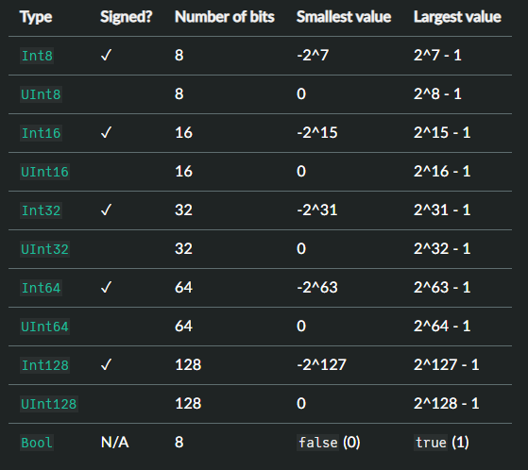
Numeric Type System
Integers (Int) are numbers that represent whole numbers, both positive and negative. Unsigned integers (UInt) are only positive integers.
The number in the type name corresponds to the number of bits needed to represent that number. For example:
UInt8 represents 256 numbers (0 –> 255), as 256 = 2⁸ = 11111111.
Int32 types represent 4294967296 numbers
(-2147483648 -> 2147483647) as 4294967296 = 2^32.
Bool types represent true or false values, used in programming for yes/no conditions.

Slide 10
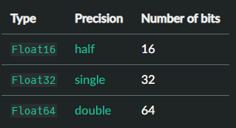
Numeric Type System
In most cases, you will be using floating point numbers.
These represent rational numbers, both + and - .
Floats sit above integers in the hierarchy,
so operations using Ints and Floats will return Floats
(automatic type promotion)
E.G. x = 3 * 8 x is an Int
y = 3.242 * 8.235 y is a Float
z = x * y z is a Float
Because Floats need more bits to represent numbers (most often 64 bits, called double-point precision), calculations using floats can be demanding of your computer hardware. Therefore, when possible use number types with lower precision to save time and computing resources.
If you are working with integers, use the Int type. If you only care about accuracy up to 6 decimal points, then maybe* use Float32. However, as scientists we will require Float64 precision 99% of the time.

Slide 11
Numeric Type System
Unless specified, numbers on each level assume the type that represents the largest possible range of numbers.
i.e. Float64 before Float32 before Int8 . . .
All number types are subsets of the types in preceding levels. So, Int128 and Int32 are both Signed integers, and therefore are also Real numbers.

Slide 12
Numeric Type System
Numbers can be promoted in the hierarchy (type promotion), but not demoted as that results in loss of precision (accuracy) leading to errors, i.e. 3.556 (Float) cannot be demoted to an Int as that would change its value to 3.
However, a whole number represented as a Float (e.g. 76.000000…) can be converted to Int as this does not cause information loss due to truncation.

Slide 13
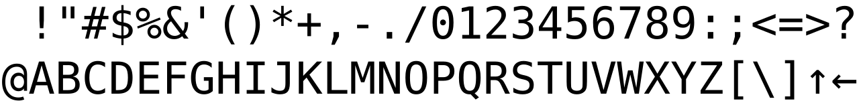
String Literals
Type System
When dealing with text, there are two important types, characters (Char) and strings of characters (String).
A Char refers to a single character or symbol, basically anything you’ll find on your keyboard. Chars are defined by using single quotation marks,
e.g. ‘d’ ‘X’ ‘#’ ‘€’ ‘2’
Chars are often referred to as ASCII or non-ASCII (American Standard Code for Information Interchange). Basically, ASCII characters are those used most in English.
Thus, letters and symbols like ‘á’ ‘€’ ‘ü’ are non-ASCII (or non-standard ASCII). ASCII is a way that symbols are encoded (assigned numbers) in order to
perform computations with text.
It is important to recognise ASCII vs. non-ASCII, as non-ASCII chars can be misinterpreted by your computer, leading to bugs and errors that are very difficult to understand…
Notes:
Reference Python and my name.
Something about

Slide 14
String Literals
Type System
One of the best features of Julia is the ease with which you can use special characters like Greek letters, currency symbols, emojis and more!
These special characters can be used as variable names too, adding a richness and improved interpretation to your code. So instead of calling a variable theta you can use the symbol for theta instead, θ.
To write these characters, use a backslash before the keyword and then press tab.
e.g. \epsilon + tab = ε
Examples:
Julia> αº = 45 # \alpha \degree, could be used to represent an angle variable.
Julia> ¥€ = 0.003 # \yen \euro, could be used to represent exchange rate variable.
Julia> σ² = 0.25 # \sigma \^2, could be used to represent a variance variable.
Julia> ☎ = +352… # \:phone:, could be used to represent a phone extension.
Notes:
Reference Python and my name.

Slide 15
String Literals
Type System
A String refers to a string of chars.
Strings are defined by using double quotation marks, e.g. “This is a string” ‘This is not a string’
A String can include ASCII and non-ASCII characters together.
A String can be any length. So, “a” is a string, but ‘a’ is a char.
A String made using 3 double quotation marks allows you to span a string over multiple lines.
Alternatively, we can use the special Unicode
symbol ‘\n’ for a new line.
e.g. “““This line
is split over
different lines”””
Is the same as
“This line\n is split over\n different lines”

Slide 16
String Literals
Type System
We can insert variables into strings using the dollar symbol ($). This is very handy when you want to display specific information to the user.
E.g. Julia> MyName = “Jeff”;
Julia> Greeting = “Hello, my name is $MyName”;
Julia> print(Greeting)
Hello, my name is Jeff
Julia> MyName = “Beyoncé Knowles”;
Julia> MyJob = “Superstar”;
Julia> AboutMe = “I’m $MyName and I’m a $MyJob”;
Julia> print(AboutMe)
I’m Beyoncé Knowles and I’m a Superstar

Slide 17
String Literals Type System
We can also combine strings together using an asterisk:
E.g. Julia> a = “Wow, who would have thought”
Julia> b = “ this workshop would be soooo good?”
Julia> c = a * b
Julia> print(c)
“Wow, who would have thought this workshop would be soooo good?”

Slide 18



Collections
As the name suggests, collections are collections of variables and items.
There are several types of collections that we will discuss:
Tuples
Arrays
Dictionaries

Slide 19
Collections: Tuples
Tuples are an ordered series of variables
(Ints, Floats, strings, chars, etc.).
Tuples are immutable – their values and the order in which that appear cannot be changed.
Tuples can consist of mixed types.
Tuple_name = (value1, value2, value3, ...)
Examples:
Julia> MyFamily = (“Mam”, “Dad”, “Sister1”, “Sister2”, “Cat”, “Dog”, “Granny”)
Julia> Ages = (63.5, 65, 28.1, 26.7, 6.25, 3.9, 109)
Julia> Shopping = (“Apples”, 4, “Beers”, 6, “Washing-Up Liquid”, 1)
Notes:
Once created, Tuples can’t be changed

Slide 20
Arrays are ordered collections of variables (Ints, Floats,
strings, chars, etc.) with multiple dimensions.
Arrays are mutable – their values and the order in which that appear can be changed.
Arrays can contain single variables, as well as subarrays.
Array_name = [item1, item2, item3, ...]
Collections: Lists
Examples:
Julia> MyFamily = [“Mam”, “Dad”, “Sister1”, “Sister2”, “Cat”, “Dog”, “Granny”]
Julia> Ages = [63.5, 65, 28, 26, 6, 3, 109]
Julia> Details = [MyFamily, Ages] # 2-element array with subarrays
Julia> Details = cat(MyFamily,Ages,dims=2) # 7x2 two-dimensional array
7×2 Array{Any,2}:
"Mam" 63
"Dad" 63
"Sister1" 23
"Sister2" 26
"Cat" 5
"Dog" 2
"Granny" 99

Slide 21
Dicts (dictionaries) are collections of variables (Ints, Floats,
strings, chars, tuples, etc.) that are identified using a key.
Dict keys must be unique, but values attached to the keys may be the same.
Dicts are unordered and can contain tuples, arrays and even subdictionaries.
Dict_name = Dict(“Key1” => item1, “Key2” => item2, “Key3” => item3, ...)
Collections: Dicts
Examples:
# This dictionary contains members of a family, where the key is the member’s name, and the item for each key is a tuple containing their age, eye colour, and whether they are vegan (true) or not (false)
Julia> MyFamily = Dict(“Mam” => (63.5, “Green”, true), “Dad” => (65, “Blue”, false), “Sister1” => (28, “Blue”, true), “Dog” => (4, “Brown”, false))
# This dictionary contains EEG data from an experiment, where each key is an EEG channel, and the item associated with each key is an array containing the data in a long stream of numbers.
Julia> EEG_Data = Dict(“C1” => [21.3,133.1,141.4,9.31,…], “C2” => [78.3,613.7,11.5,89.14,…], “C3” => […])
Notes:
The first example could just as easily been subjects in an experiment.

Slide 22

Overview of Objects
When we create variables and collections, what we are creating are objects, items that must be stored (on RAM) in order to be called and reused.
Objects can be a variables like a string, char, int or float,
Collections like tuples, arrays, or dicts,
or even functions, data structures or methods (we will cover these later).
In Julia, a hash or ID is assigned to a variable when it is created. That way, the value of the variable can change, but it remains the same object/entity.
So when you call an object, Julia looks up the ID of that object and retrieves it in the computation.
e.g.
Julia> x = 32
Julia> objectid(x)
0x7950fdde1890bf19
Notes:
There is more to objects, which we will cover in later lectures.

Slide 23
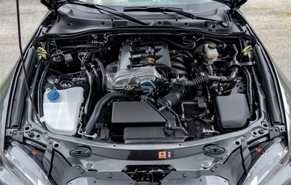
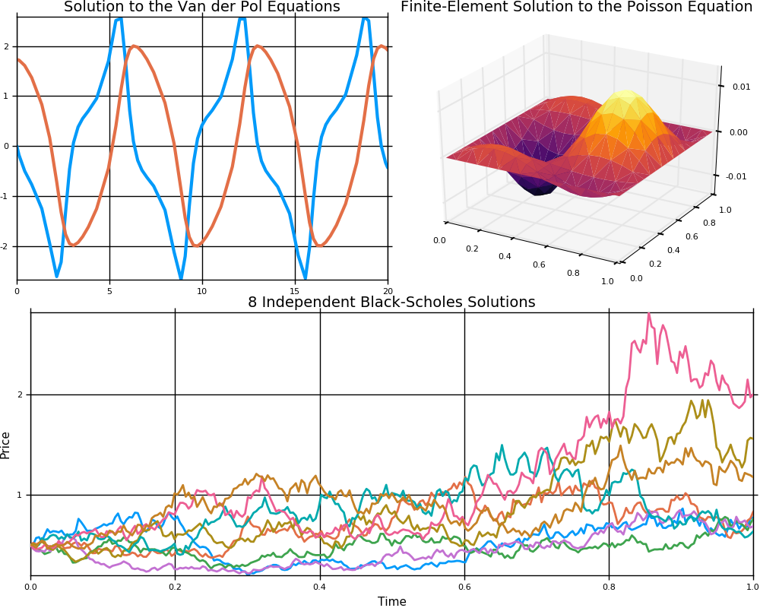
Plotting in Julia
Plotting in Julia is mainly done using the Plots.jl package (although there are others).
The functions and methods in Plots.jl provide the interface through which the user communicates to the plotting software under the hood, i.e. the backend.
Like internet browsers, Julia has several plotting backends that fundamentally do the same thing, but with different appearance and features.
The default backend is the GR backend, but we can also use Plotly, PyPlot (which uses the syntax of matplotlib) and many others. The choice of plotting backend depends on speed, interactivity and appearance.
We will compare the GR and Plotly backends, both installed alongside Plots.jl

Slide 24

Plotting in Julia
The Homework from last week was to install the ‘Plots’ package (and several others).
Did you do your homework?

Slide 25
Like learning a real language, the only way to become fluent is to practice.
OK, let’s start writing some code!!!

Slide 26
For Beginners!
Homework Week 2:
Complete exercise sheet for week 2.

